Slide 1
RISC-V Floating-Point CPU
Yuval Gerzon 205738024
David Jotkowitz 323601013
Dr. Amit Berman
Spring Semester 2021
07/02/2022

Slide 2
Presentation Layout
RISC-V ISA
Floating Point
Software Reference Model
Hardware
Verification Testing
Synthesis and Board Design
Conclusion

Slide 3

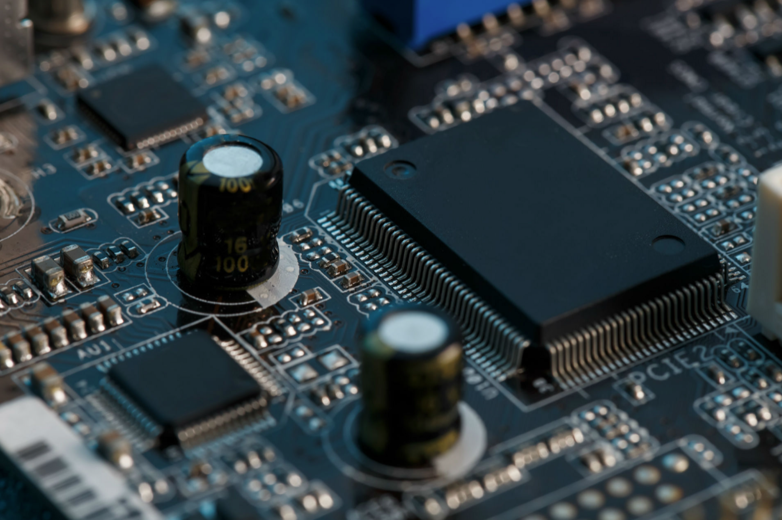
RISC-V ISA

Slide 4
RISC-V ISA
 | RISC | CISC
Amount of general-purpose registers necessary | More | Less
Datatypes | Usually two (int and float) | Usually more than two
Instructions | Load/store general registers, operations on datatypes in registers | Correspond to datatypes
Instruction formats | Fixed length, two main types: Load/store, R = R op R | Variable length, many types: Load/store, R = R op R, R =Mem op R, M =Mem op Mem
Encoding | 1 instruction= 1operand or 1 operation | 1 instruction= 1 statement
Design objective | Trade off program length, minimize time to execute instruction | Minimum program length Maximum work/instruction
Implementation | Hard-wired processor and software. Fast processor and fast cache for instructions; instructions take one clock cycle; simple pipeline | Microprogrammed processor; slow primary memory and fast clock: instructions take variable time; pipeline is complex; larger implementation may result in longer design time
Caching | Essential for instructions | Useful
Compiler design | Should stress best ordering | Should stress finding right instructions
Philosophy | Move all functions to software | Move any useful software function into hardware, including diagnostics.
Developed at Berkley university of California in 2010
Open Source
Standard extensions: “I” (mandatory base integer), “F” (single-precision floating point), “D” (double-precision floating-point), “M” (multiplication and division for integers), “A” (atomic instruction extension, supports inter-processor synchronization operations).
Many other extension for specific applications (for example “P” for SIMD instructions)
Various instructions lengths, we will focus on the 32-bit instructions

Slide 5
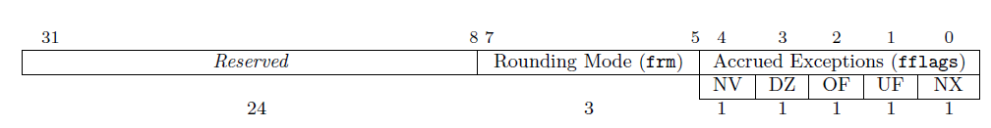
RISC-V ISA
Memory:
32 registers (one always zero)
Cache (no single standard)
RAM (compatible to 32- or 64-bit format respectively to RV32G and RV64G)
FCSR (holds flags- invalid operation, divide by zero, overflow, underflow, inexact; and dynamic rounding mode)

Slide 6
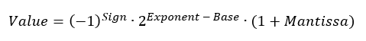
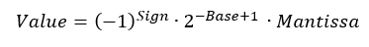
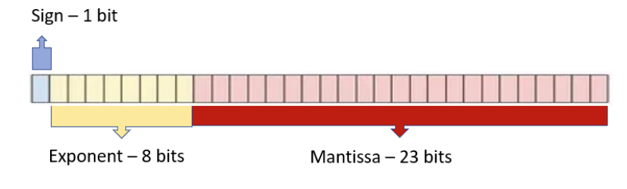
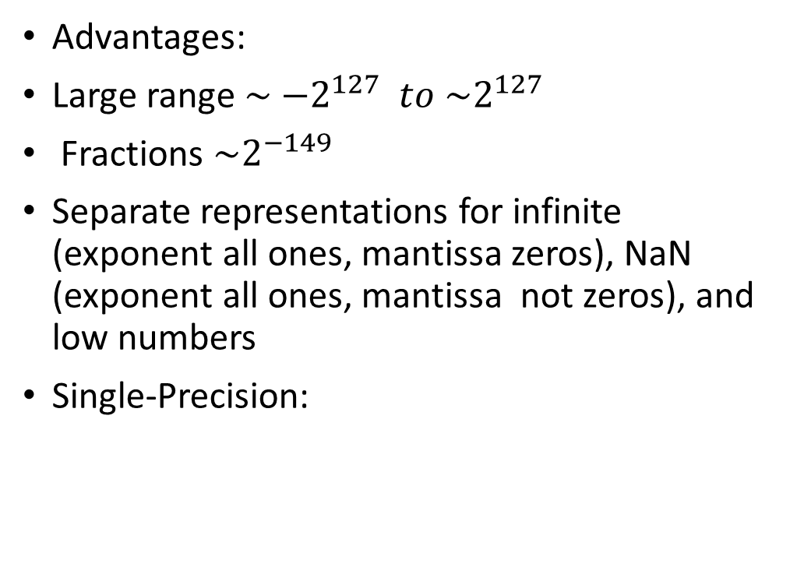
Floating Point
Advantages:
Large range $\sim {−2}^{127} to \sim 2^{127}$
Fractions $\sim 2^{−149}$
Separate representations for infinite (exponent all ones, mantissa zeros), NaN (exponent all ones, mantissa not zeros), and low numbers
Single-Precision:

Slide 7
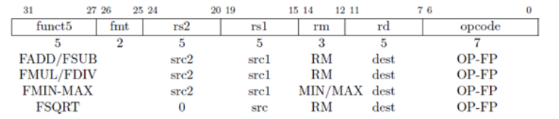
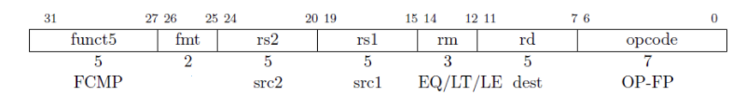
Floating Point
Operations:
Load/Store
FADD, FSUB
FMUL, FDIV
FMIN-MAX, FCMP
FSQRT
FMADD, FMSUB
FCVT
FCLASS

Slide 8
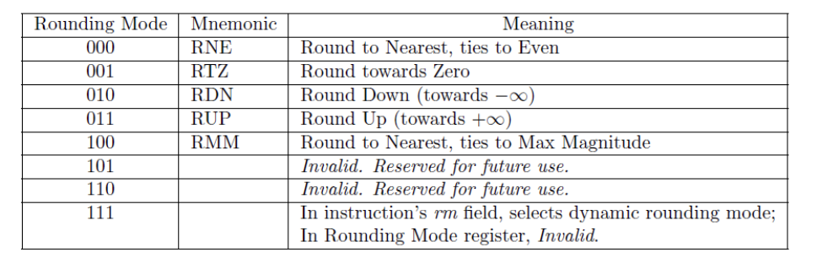
RISC-V ISA
Rounding Modes:

Slide 9
Software Reference Model
RISC-V pipelined CPU in python3
Instruction fetch, Instruction decode, Execute, Memory, Write back
Implemented the pipeline and the arithmetic in separate files
For bits, we used lists of 32 integers and kept them as ones and zeros, in order to create our register class
Left parameters to change to double or quad precision

Slide 10
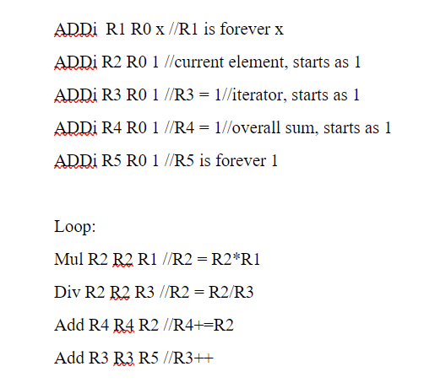
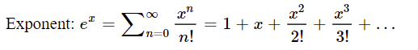
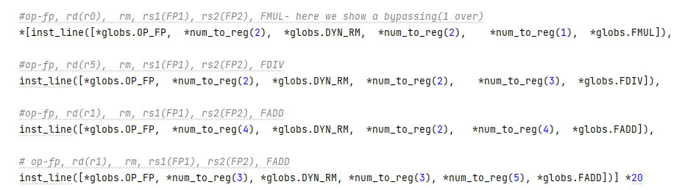
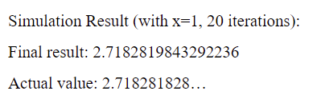
Software Reference Model
For verification of the model, we ran three programs that calculated the sum of a series:

Slide 11
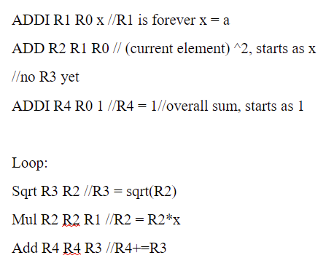
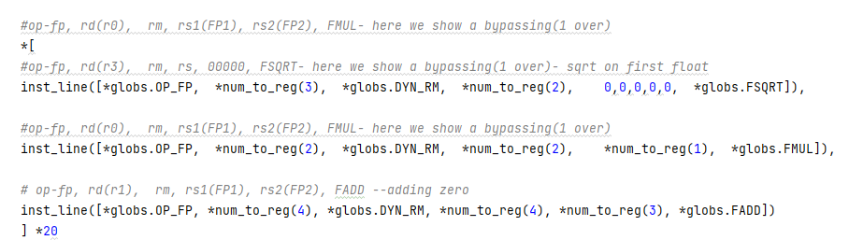
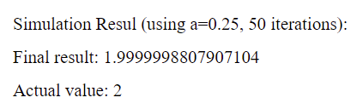
Software Reference Model

Slide 12
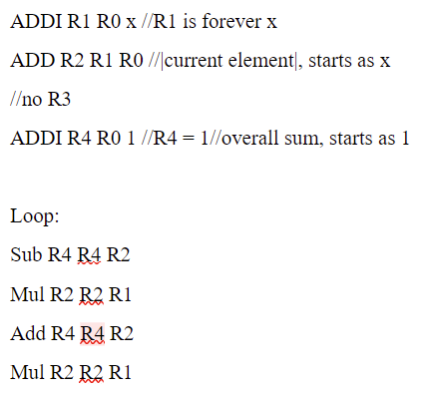
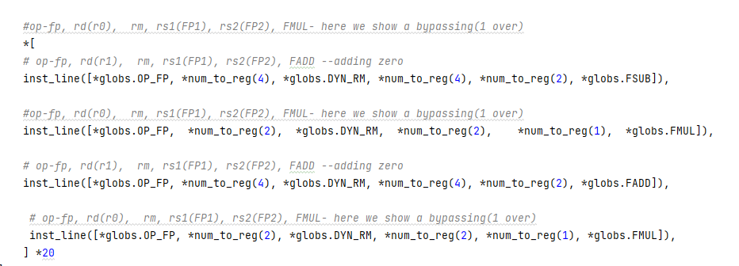
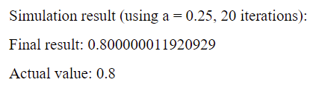
Software Reference Model

Slide 13
Software Reference Model
Floating point representation limitation
Value achieved at infinite series
Also implemented with different RM besides RTZ

Slide 14
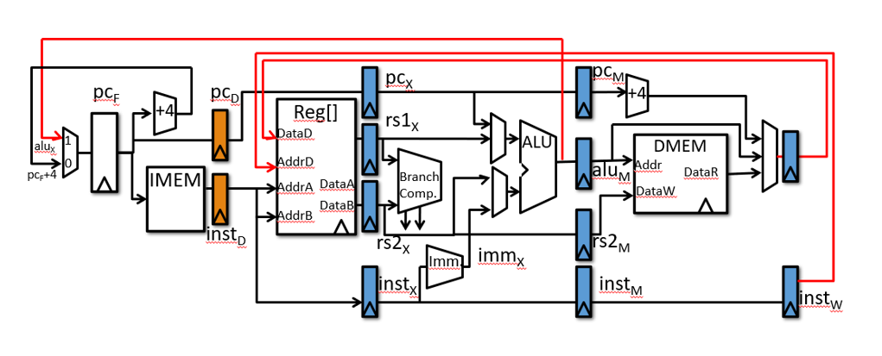
Hardware

Slide 15
Hardware
Addition, Subtraction, Multiplication and Division operations on William Stallings “Computer Organization and Architecture 6th edition
We considered implementing different RM but shelved the idea

Slide 16
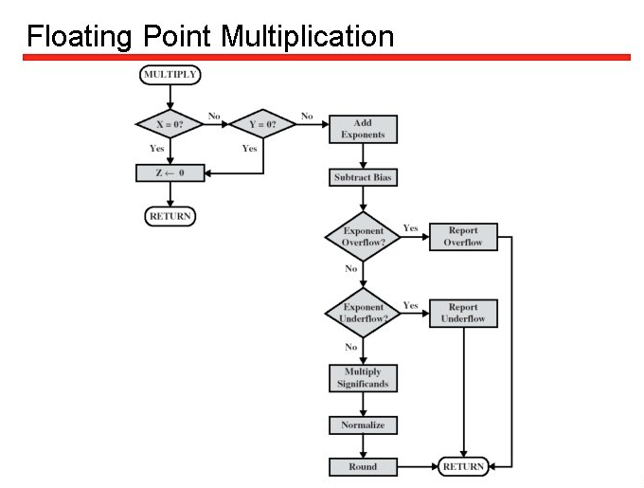
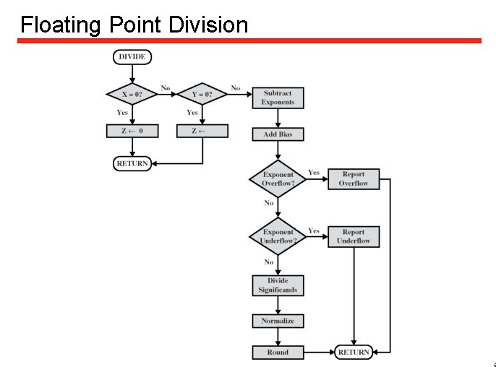
Hardware
In general, multiplication and division had similar implementations

Slide 17
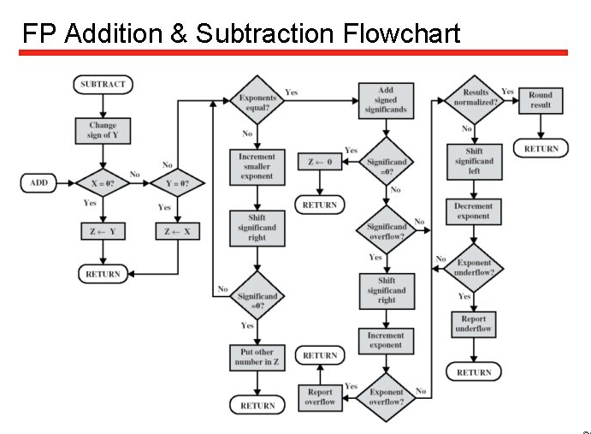
Hardware

Slide 18
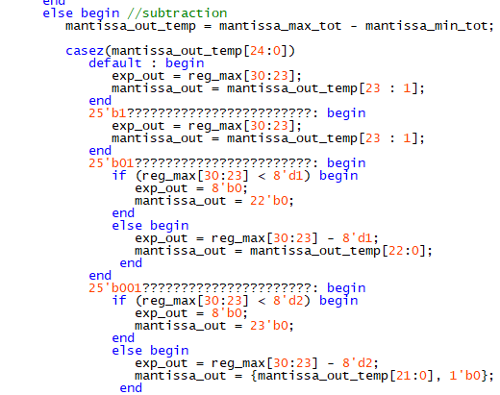
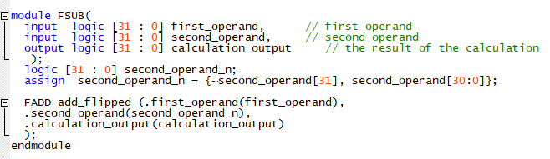
Hardware
A challenge we had with addition was how to shift the mantissa according to the result. We overcame this by using a case statement, but other options were considered
Subtraction implemented by using an env module for addition

Slide 19
Hardware
Implementing FSQRT posed a challenge. After deliberation, we decided to implement it with a multi-cycle Taylor expansion
For the intermediate calculation stages, we implemented a “halt” signal as an input to the control module that stop the progress through the pipeline
Calculating the square root of a value by expansion is especially suited for floating point representations- by shifting the exponent right by one, we already have a good estimation
To cover the full precision, we took five expansions

Slide 20
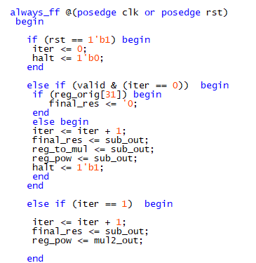
Hardware
$\sqrt{b}≈Y_{0}(1−\frac{1}{2}\left(1−\frac{b}{Y_{0}^{2}}\right)−\frac{1}{8}{\left(1−\frac{b}{Y_{0}^{2}}\right)}^{2}−\frac{1}{16}{\left(1−\frac{b}{Y_{0}^{2}}\right)}^{3}−\frac{5}{128}{\left(1−\frac{b}{Y_{0}^{2}}\right)}^{4}$ $−\frac{7}{256}{\left(1−\frac{b}{Y_{0}^{2}}\right)}^{5})$
For implementation, we used two FMULs, an FDIV, and an FSUB. We saved their outputs in registers and alternated their inputs according to the series stage
We made a “valid” input from the ALU for the beginning of calculation

Slide 21
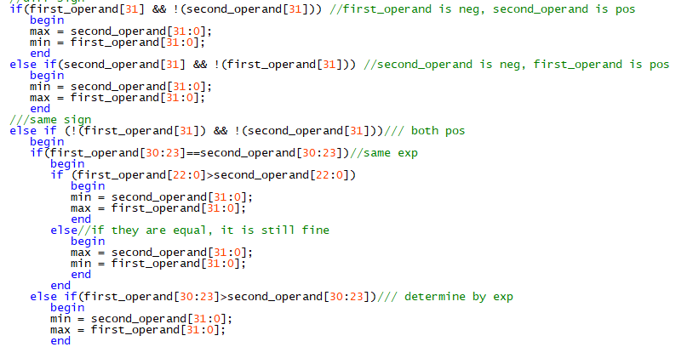
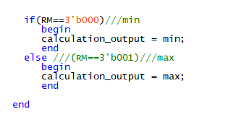
Hardware
The non-arithmetic operations were straightforward- we first looked at the sign, then the exponent, then the mantissa for comparison
Then we determined the output according to the RM field

Slide 22
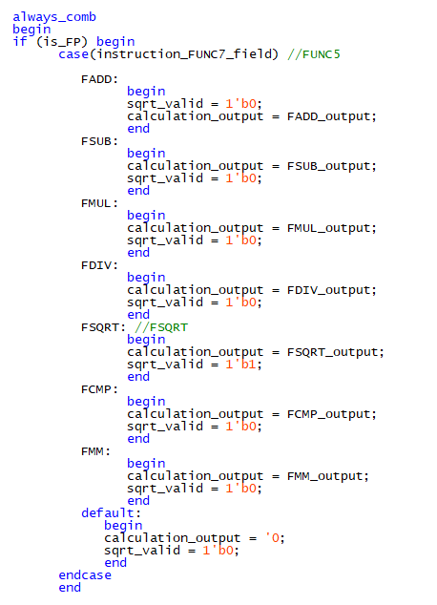
Hardware
We then enveloped all the modules into an ALU_FP that determines the execution output according to the instruction received from the control module

Slide 23
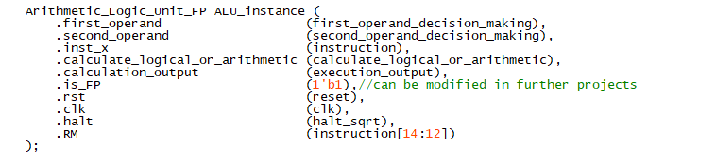
Hardware
As our project was focused on the floating-point expansion, we just needed to add our ALU into an existing CPU with some minor adjustments for the halt signal from the FSQRT
We will mention that for the reference module we did implement a new microprocessor

Slide 24
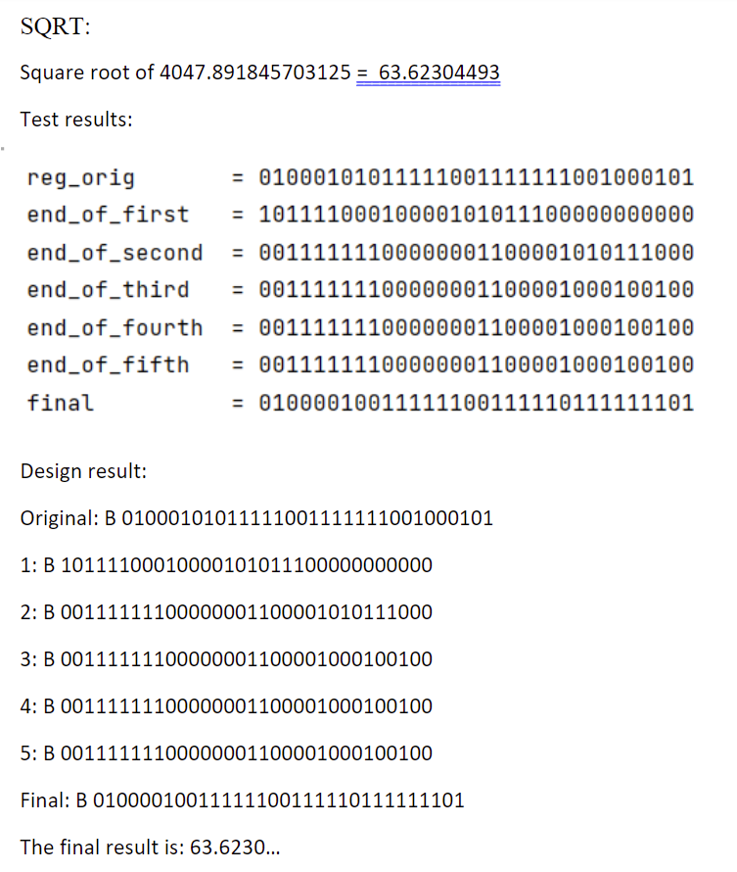
Verification Testing
The testing took a while until all the modules worked exactly how we wanted them to. We tested all corner-cases and achieved full coverage for all modules, with an emphasis on our ALU modules
Only the FSQRT module needed a clk signal, the rest operated on a single cycle
The tests and results can be found in the project folder

Slide 25
Synthesis and Board Design
After completing the design and verification of our CPU, we compiled and synthesized our design
Due to a last-minute mistake by using the top CPU (that we didn’t design ourselves), only clk and rst inputs were given to our total module. The instructions and memories were hard-coded
The main timing bottleneck was in the FSQRT flow

Slide 26
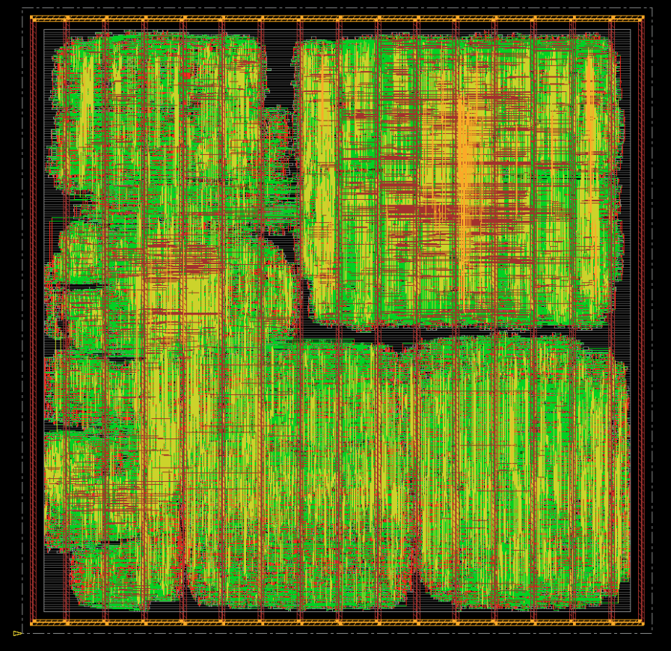

Synthesis and Board Design

Slide 27
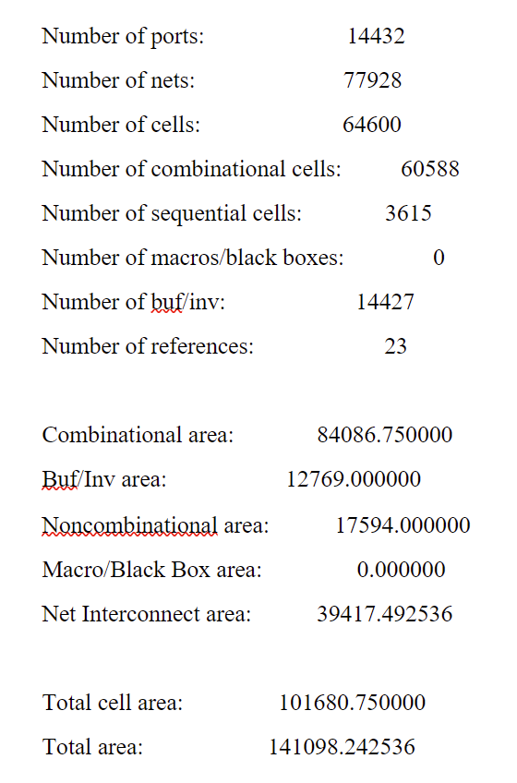
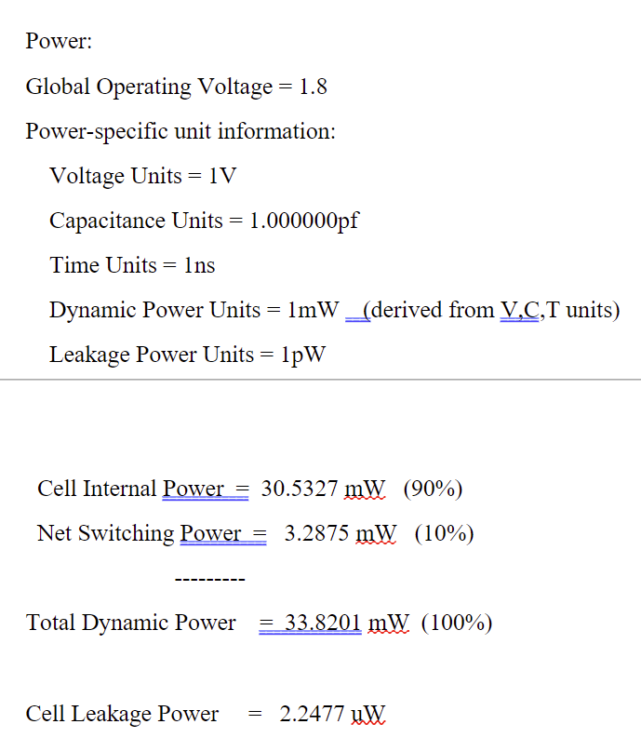
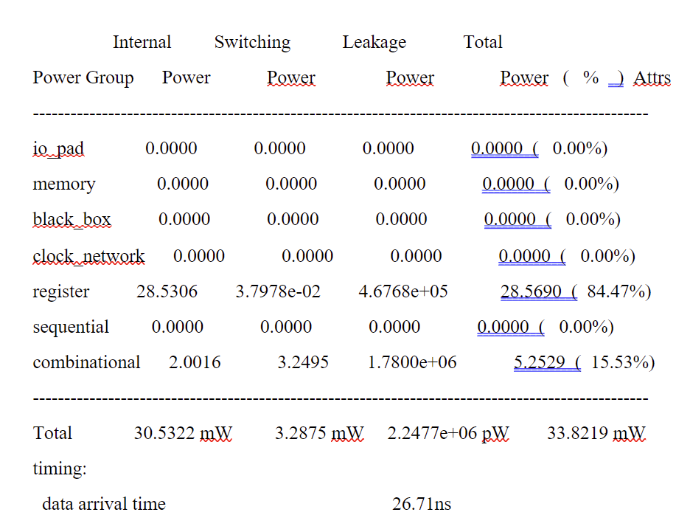

Synthesis and Board Design

Slide 28
Conclusion
We appreciated the opportunity to see the whole process of making a chip, from delving into literature to having a physical design
We both work in the field and feel confident that we’ve gained important tools for our careers
We would like to express gratitude to Dr. Amit Berman who guided us through the process and Mr. Goel Samuel who helped us synthesize our work and gave useful suggestions throughout the process

Slide 29

Thanks For Listening!

Slide 30
Sources Used
The RISC-V Instruction Set Manual Volume I: User-Level ISA Document Version 2.2
William Stallings, computer organization and architecture 6th edition
Floating-Point Division and Square Root using a Taylor-Series Expansion Algorithm, Taek-Jun Kwon, Jeff Sondeen, Jeff Draper University of Southern California / Information Sciences Institute Marina del Rey, U.S.A. {tjkwon, sondeen, draper}@ISI.EDU
Floating-point Square Root Calculation Arithmetic Based on Taylor-Series Expansion and Region Division, Jianglin Wei, A. Kuwana, H. Kobayashi K. Kubo, Y. Tanakas

